Slide 1


Title slide + image
Git Workshop
(Sit in your subgroups from IP2)
Inge Schmidt | ETV

Slide 2

Structure
Create/edit a Hyperlink TO A SLIDE
1
Go to the tab ‘Insert’ and click on the button ‘Shapes’. Choose the shape ‘Rectangle’ and drag the mouse over the slide to create a shape.
Shapes
2
Drag the shape over the menu button and scale the shape as large as the button. Click with the right mouse button on the shape and choose ‘Edit shape’.
Size and position…
Edit shape…
3
Click on the paint bucket icon, click on ‘Shape Fill’ and drag the ‘Transparency’ slider to 100%. Now the shape is completely transparent.
01
02
03
04
05
Introduction
What is Git?
How to use Git
Common practices
External Links
Transparency
100%
4
Click on the transparent shape and use the shortcut Ctrl + K to add a hyperlink. At the left side of the window, click on ‘Place in this document’ and select the preferred slide
in the list. Then click on ‘OK’.
5
Copy the transparent shape and repeat
step 4. Do this for all menu buttons.
Want to know more?
Go to the tab 'SLIDEBUILDER’ and click
on the button ‘Inspiration'
Inspiration

Slide 3
Chapter | dark mode
01
Introduction
Reasons to use Git

Slide 4
Introduction - Git
    Version control for text files
    Linus Torvalds (Linux creator)
    Junio Hamano
    Development: 2005-present
    Used by all programmers & most companies
    And can be useful in IP2, IP3, Chip design, Next Gen and BAP

Slide 5
Introduction - Required software
Git from https://git-scm.com/install
VS Code from https://code.visualstudio.com/download
VS Code Git Graph extension from https://marketplace.visualstudio.com/items?itemName=mhutchie.git-graph
Access to your gitlab repository on https://gitlab.ewi.tudelft.nl/ee1l2/2025-2026

Slide 6
Chapter | colour mode
02
What is Git?
Short description

Slide 7



Commits, branches and remotes
Keep track of projects
Commits and Branches
Git vs remote
  GitHub
  Gitlab
Terminology

Slide 8
Chapter | colour mode
03
How to use Git
Terminal and VScode

Slide 9
Disclaimer
I’m a user not an expert
I show one way, there are many

Slide 10
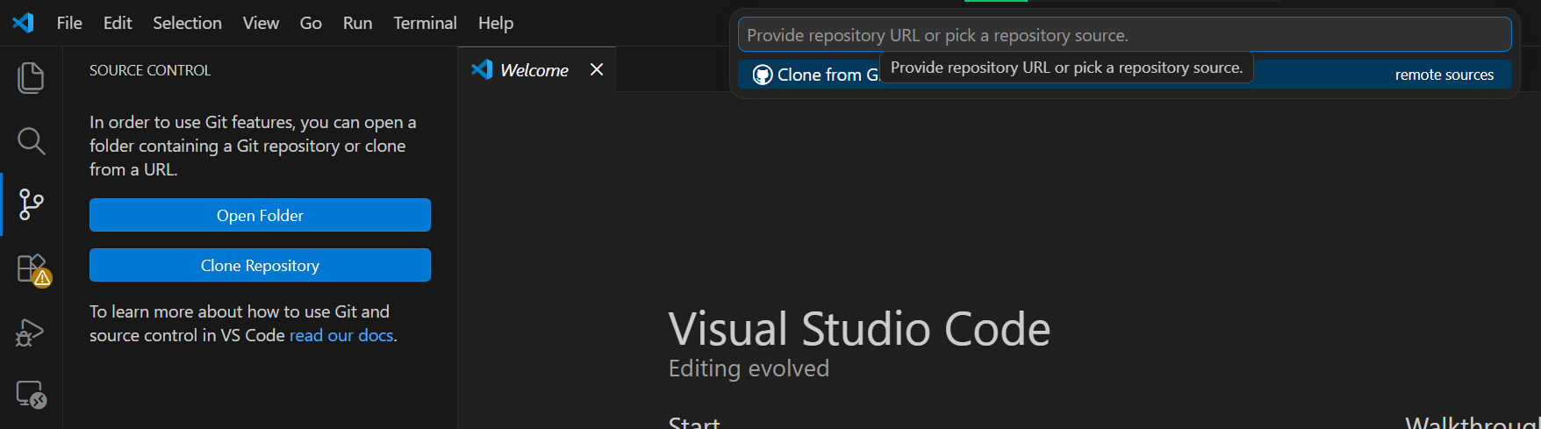

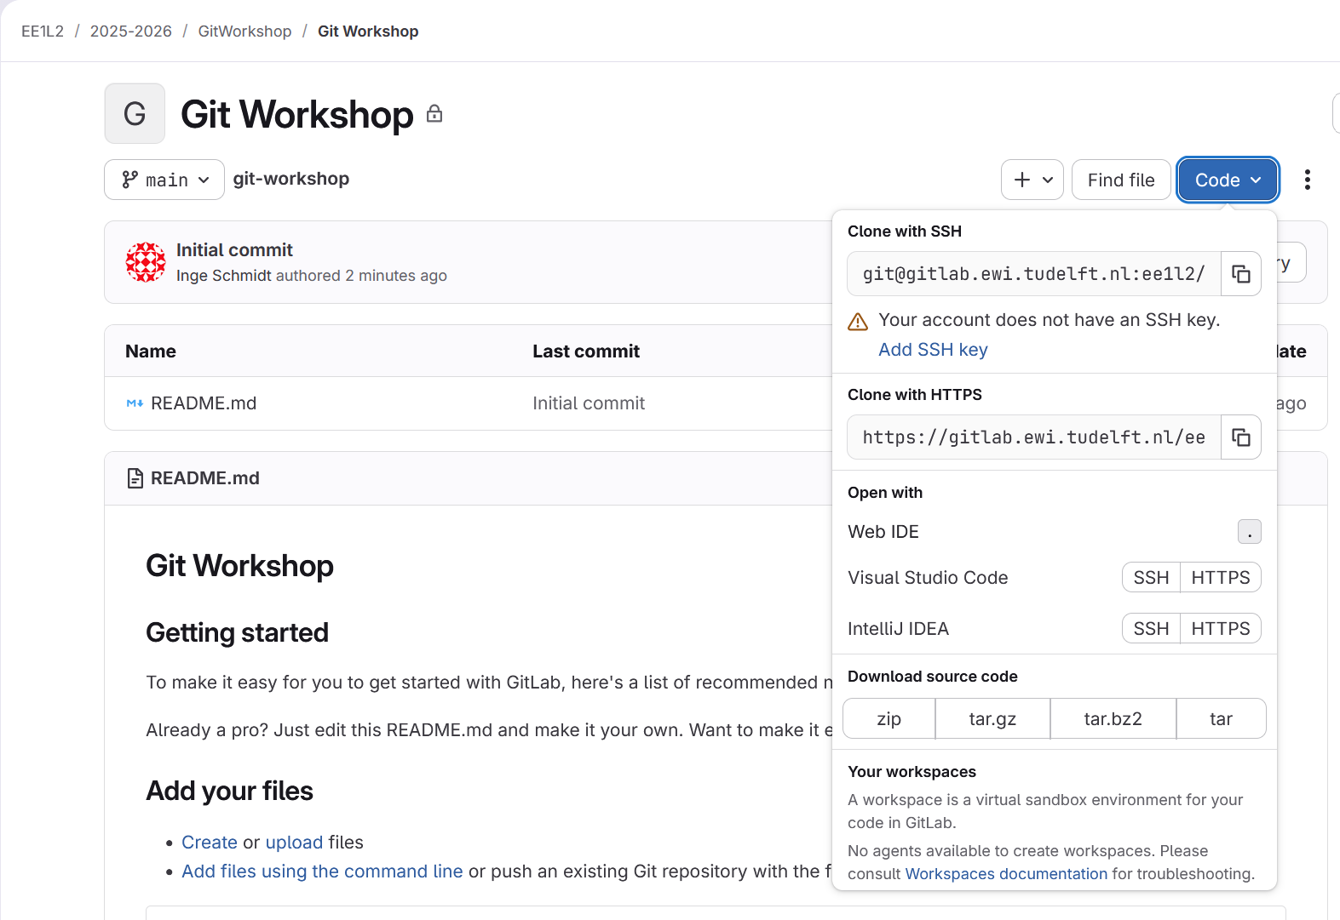
Cloning a repository
Make a local copy of the project
Find your Git repository on GitLab
Copy the HTTPS link (SSH tutorial can be found in the links at the end)
Go to a new project in VSCode
Close an open project if necessary
Paste the link and log in using your personal access token (next slide)

Slide 11
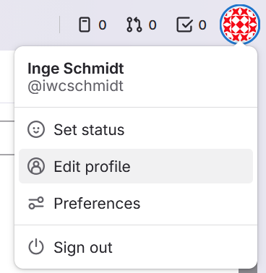
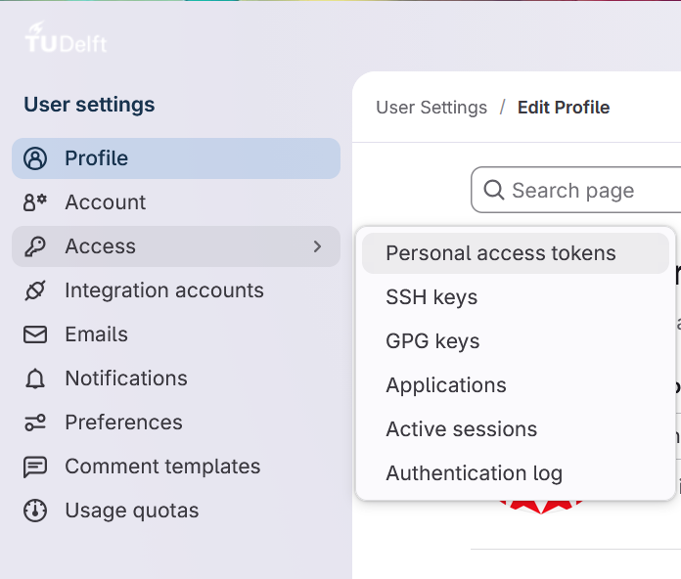
Cloning a repository
Go to new project directory
cd C:\my\new
mkdir directory
cd directory
Clone using https
git clone https://gitlab.project.git
Make sure you can log into the remote for https, for gitlab: create personal access token
Clone using ssh
git clone git@gitlab.project.git

Slide 12
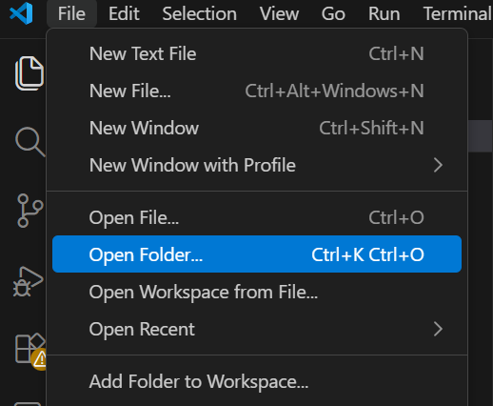
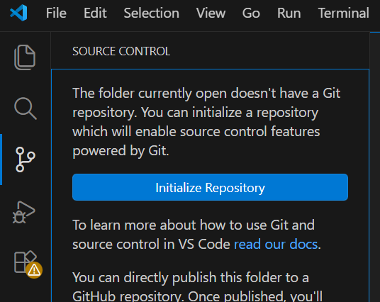
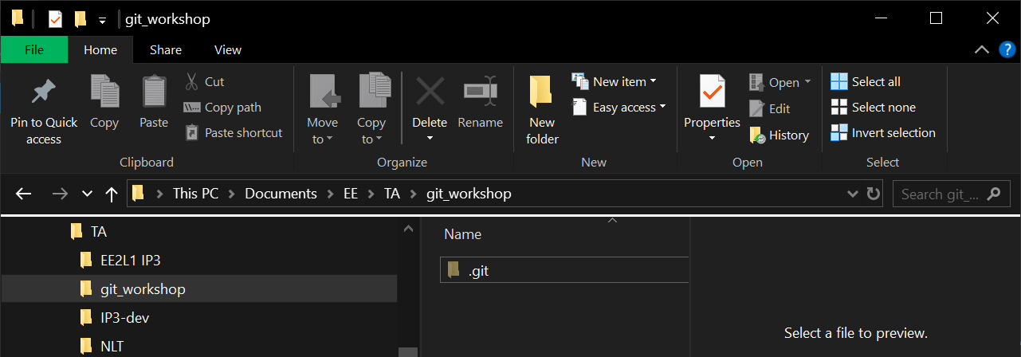
Initialising a repository
Go to project directory
cd C:\project\directory
Initialise repository
git init
See hidden .git folder by allowing file explorer if you want

Slide 13
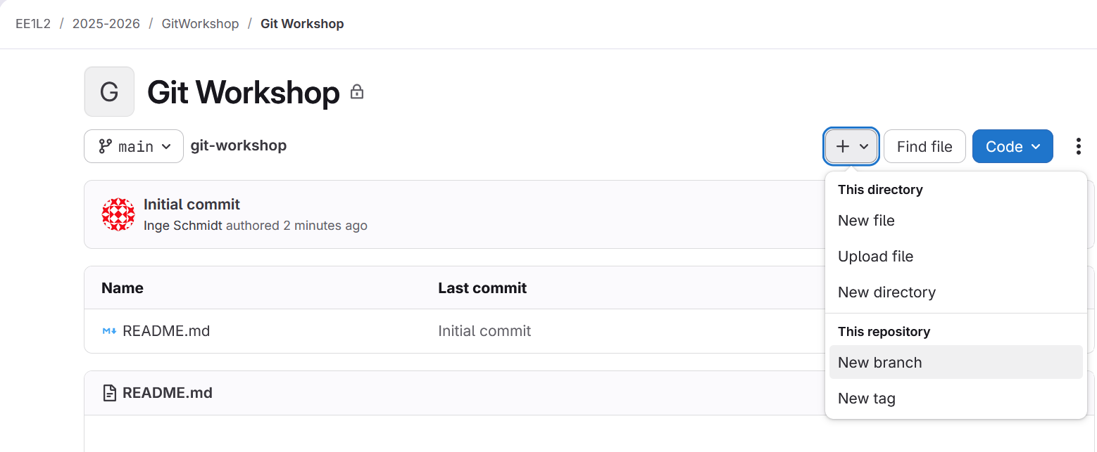
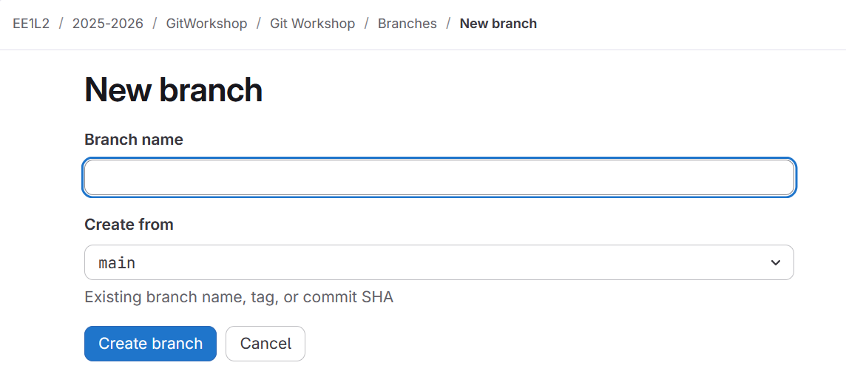

Git branch (remote)
Working in parallel (safely)
Make a new branch with a unique name
Creating a branch at the remote is easiest and can be combined with issue creation
tddddd

Slide 14
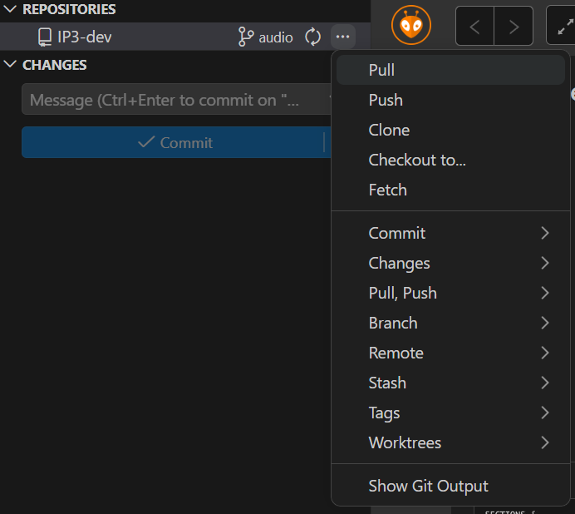
Remote repository Fetch
Working together by tracking changes
See remote changes
git fetch
Use git fetch to see new branches on your local repository

Slide 15
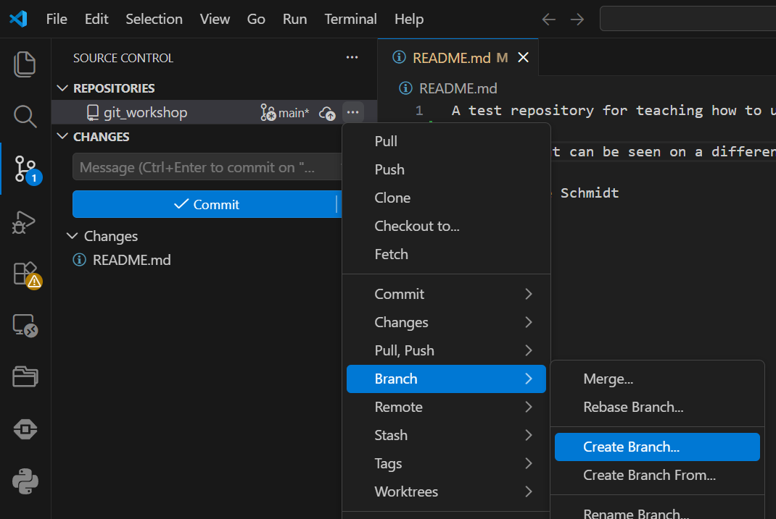
Git branch (local)
See all branches of the repository
git branch
Create branch
git branch new_branch
Go to branch
git checkout branch
Or create them directly
git checkout –b new_branch
Navigate to your new branch using git pull and using checkout (or the branch overview)
tddddd
Branch overview

Slide 16
Remote repository -Pull
pull->change file->add->commit->pull->push
Working together by tracking changes
Pull remote changes
git pull
Push local changes to remote
git push
Creating new branches push the branch using
git push –set-upstream origin <branch>
Use git pull to see if anything has changed on the remote

Slide 17
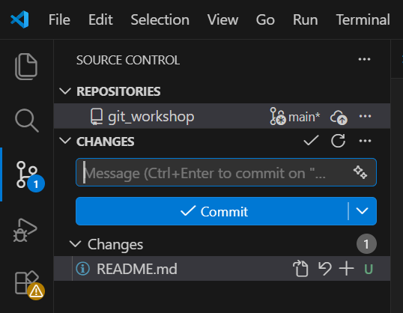
Git add
pull->change file->add->commit->pull->push
Specify what to commit
Add file to next commit
git add file.txt
Add all files to next commit
git add . or git add *
Make some changes to the file in the repo and “stage” the changes using add or the “+”
my_branch

Slide 18
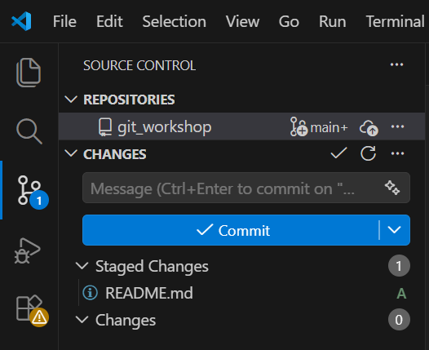
Git commit
pull->change file->add->commit->pull->push
Record your changes
Message is required
Staged changes are committed
Create a commit
git commit –m “message”
Commit your staged changes
my_branch

Slide 19
Remote repository -Push
pull->change file->add->commit->pull->push
Working together by tracking changes
Pull remote changes
git pull
Push local changes to remote
git push
Creating new branches push the branch using
git push –set-upstream origin <branch>
Use git push to upload the changes to the remote
Always use:
pull->change file->add->commit->pull->
push

Slide 20
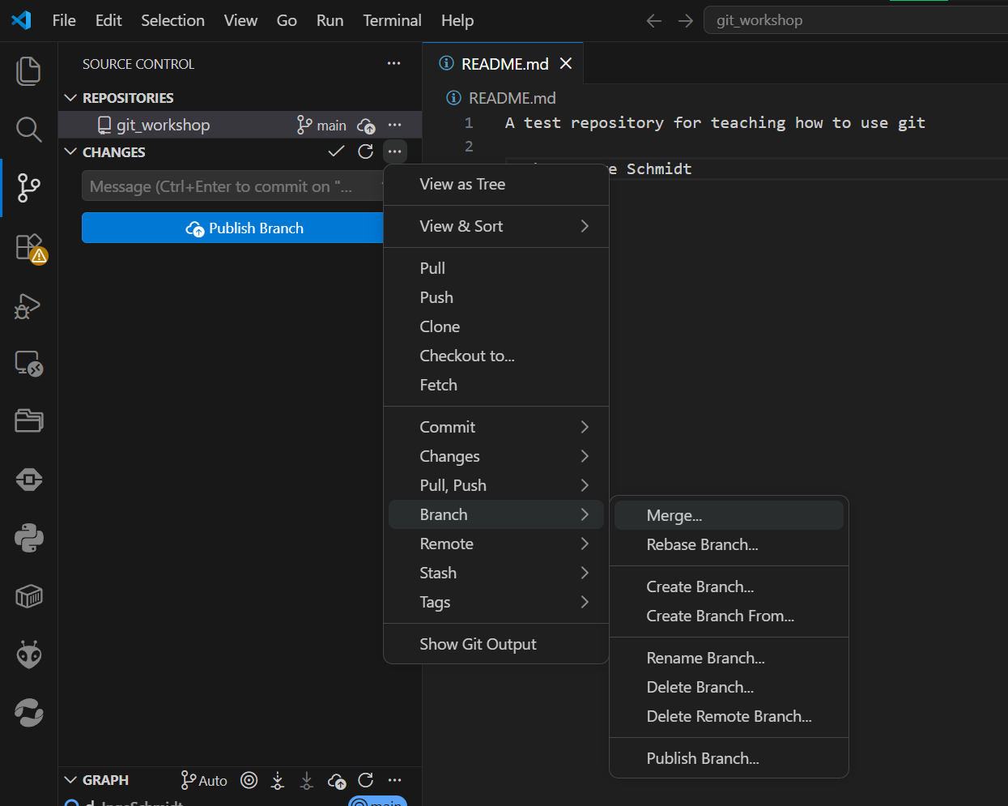
Git merge
Merge branch one into main
git checkout main
git merge one
Merge your changed branch into main using VSCode or the terminal
Merge to main: Create a merge request on GitLab, let your teammate accept it and use git fetch to see what the changes on your local repository

Slide 21
Git merge DIY
Merge branch one into another
git checkout another
git merge one
Now create two branches from main, and change the same line in both branches (for example, change the print statement)

Slide 22
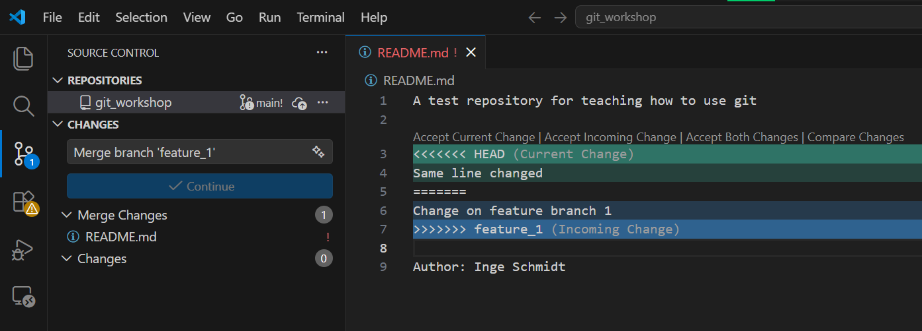
Merge conflict
Find files with merge conflict
git status
Find merge conflict markers in a text editor
<<< is what is on current branch
>>> is what is on the other
=== devides the changes
Stage and commit changes
Resolve the merge conflict from the result of the last task
Remove markers and keep the change that is right

Slide 23
Chapter | colour mode
04
Common practices
And some other handy tools

Slide 24
Pipeline
Using git and remote effectively and safely:
begin with pull at start,
then,
pull->change file->add->commit->pull->push

Slide 25

Main branch – feature branch
Use main branch as the “always working” branch
Use feature branches to make adjustments and add new functionality
Merge using merge or pull requests on the host website

Slide 26
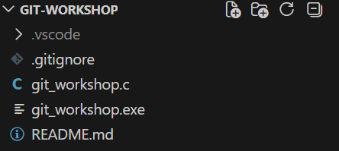
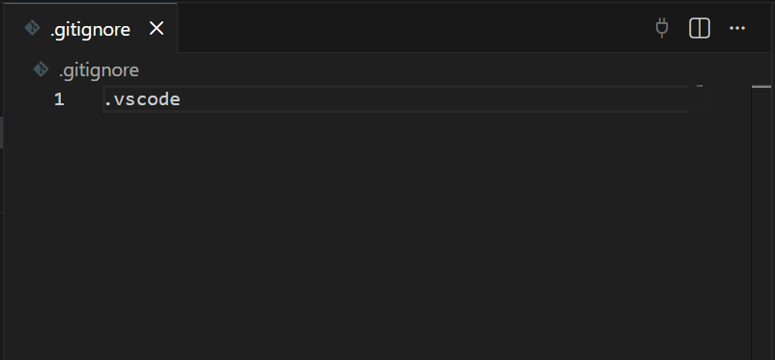
Gitignore
Have a file called .gitignore
If you add any directory like /.vscode or file extension .png these files will be disregarded by git in your local repository

Slide 27
Not covered but handy
Add a remote repository to your project (other way around)
Add SSH key to your remote repository host for easy safe connection

Slide 28
Chapter | colour mode
05
External links
Try it out yourself

Slide 29
Useful tutorials/cheat sheets
    Simple guide - https://rogerdudler.github.io/git-guide/
    Cheat sheet - https://git-scm.com/cheat-sheet
    Merge tutorial - https://www.w3schools.com/git/git_merge_conflicts.asp
    SSH Key - https://docs.gitlab.com/user/ssh/
    VS Code Git - https://code.visualstudio.com/docs/sourcecontrol/overview

Slide 30
Sources
    R. Kavinkumar, “90% of Companies Use Git. Why Are So Many Developers Still Ignoring It?,” LinkedIn, Oct. 19, 2025. [Online]. Available: https://www.linkedin.com/pulse/90-companies-use-git-why-so-many-developers-still-ignoring-r-o0r0c

