Slide 1
LaTeX workshop
The 152nd Board

Slide 2
Agenda
Introduction
  What is LaTeX?
  Why do we use LaTeX?
LaTeX
  How does it work?
  How do you use it?
  Important elements
Do it yourself!

Slide 3
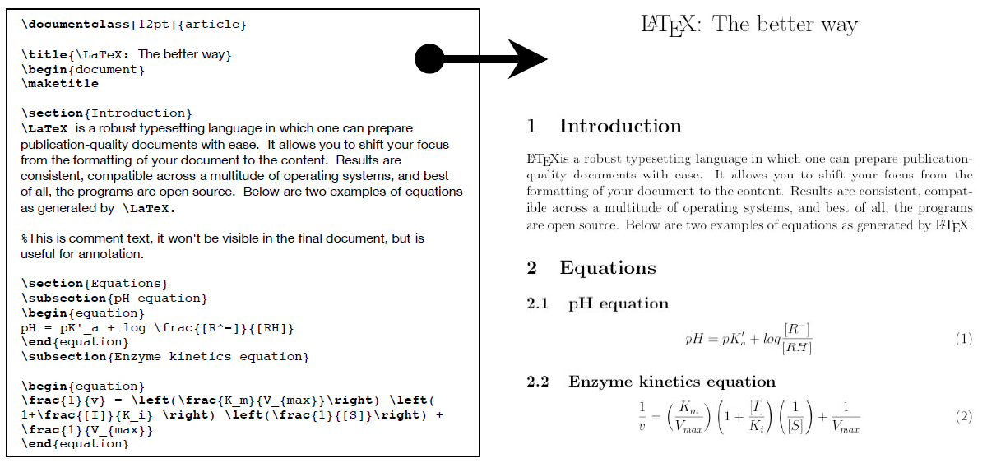
Introduction ─ What is LaTeX?
Mark-up language like HTML + CSS
Not a text editor like Word!

Slide 4
Introduction ─ Why do we use LaTeX?
Professional:
  Looks good
  Latex handles layout
  Uniformity in documents
Scientific features
Working together and splitting up the document

Slide 5
LaTeX itself

Slide 6
How does it work?
Mark-up language, so you need to compile CoDe to generate a pdf
Compiler: eg. LuLaTex, XeTex
LaTeX editors:
  TexStudio
  TexWorks
  Overleaf

Slide 7
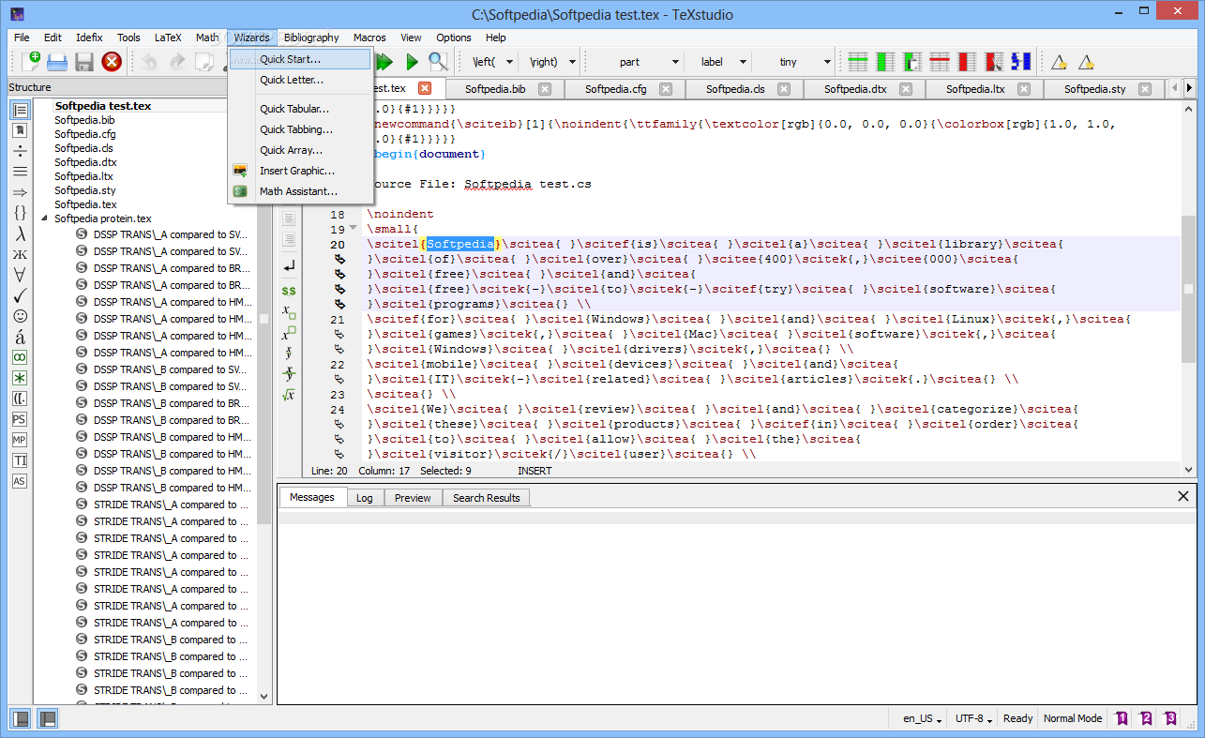

What does it look like? TexStudio:

Slide 8
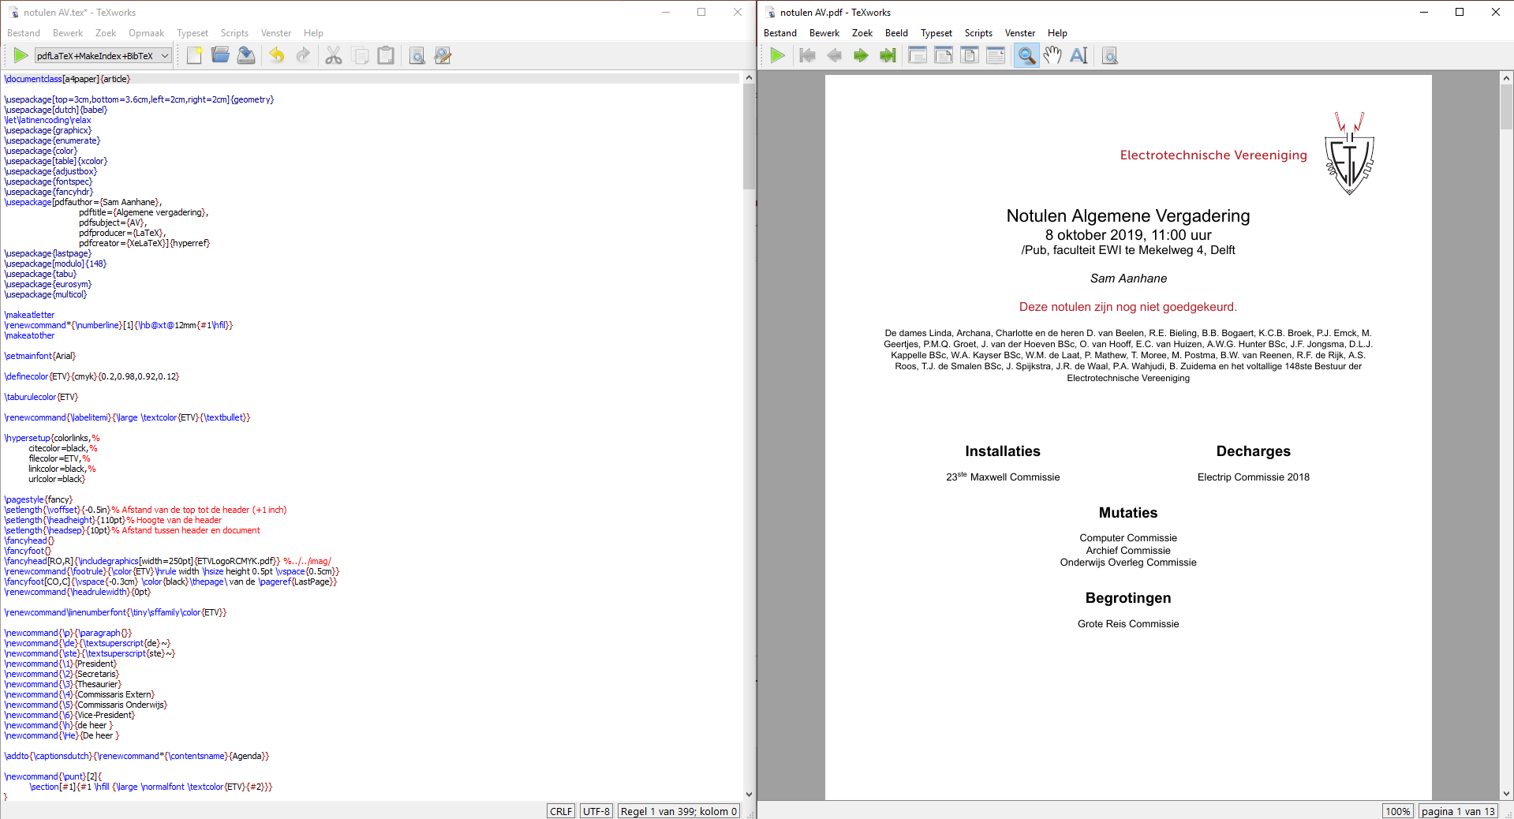
What does it look like? TexWorks:

Slide 9
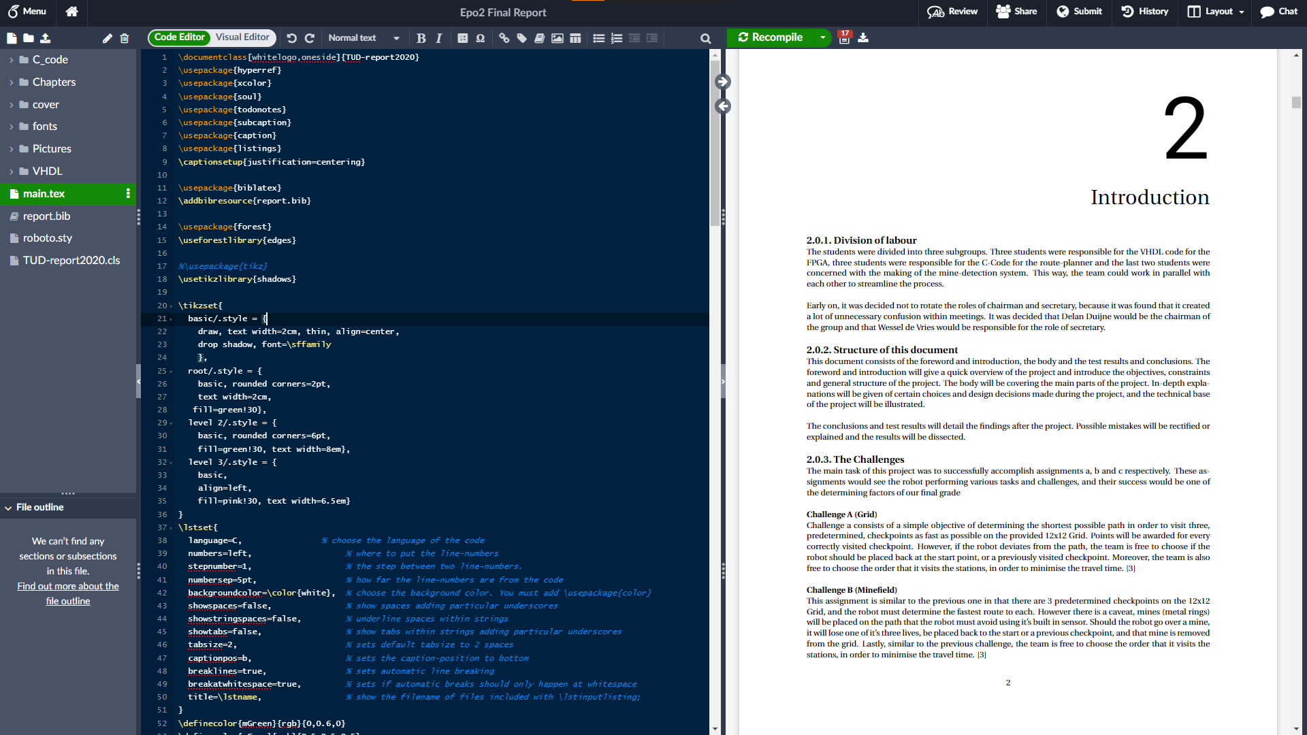
What does it look like? Overleaf:

Slide 10


How do you use it?
titlepage.tex
chapter1.tex
chapter2.tex
chapter3.tex
chapter4.tex
references.bib
\input
Compiling
report.tex
report.pdf

Slide 11
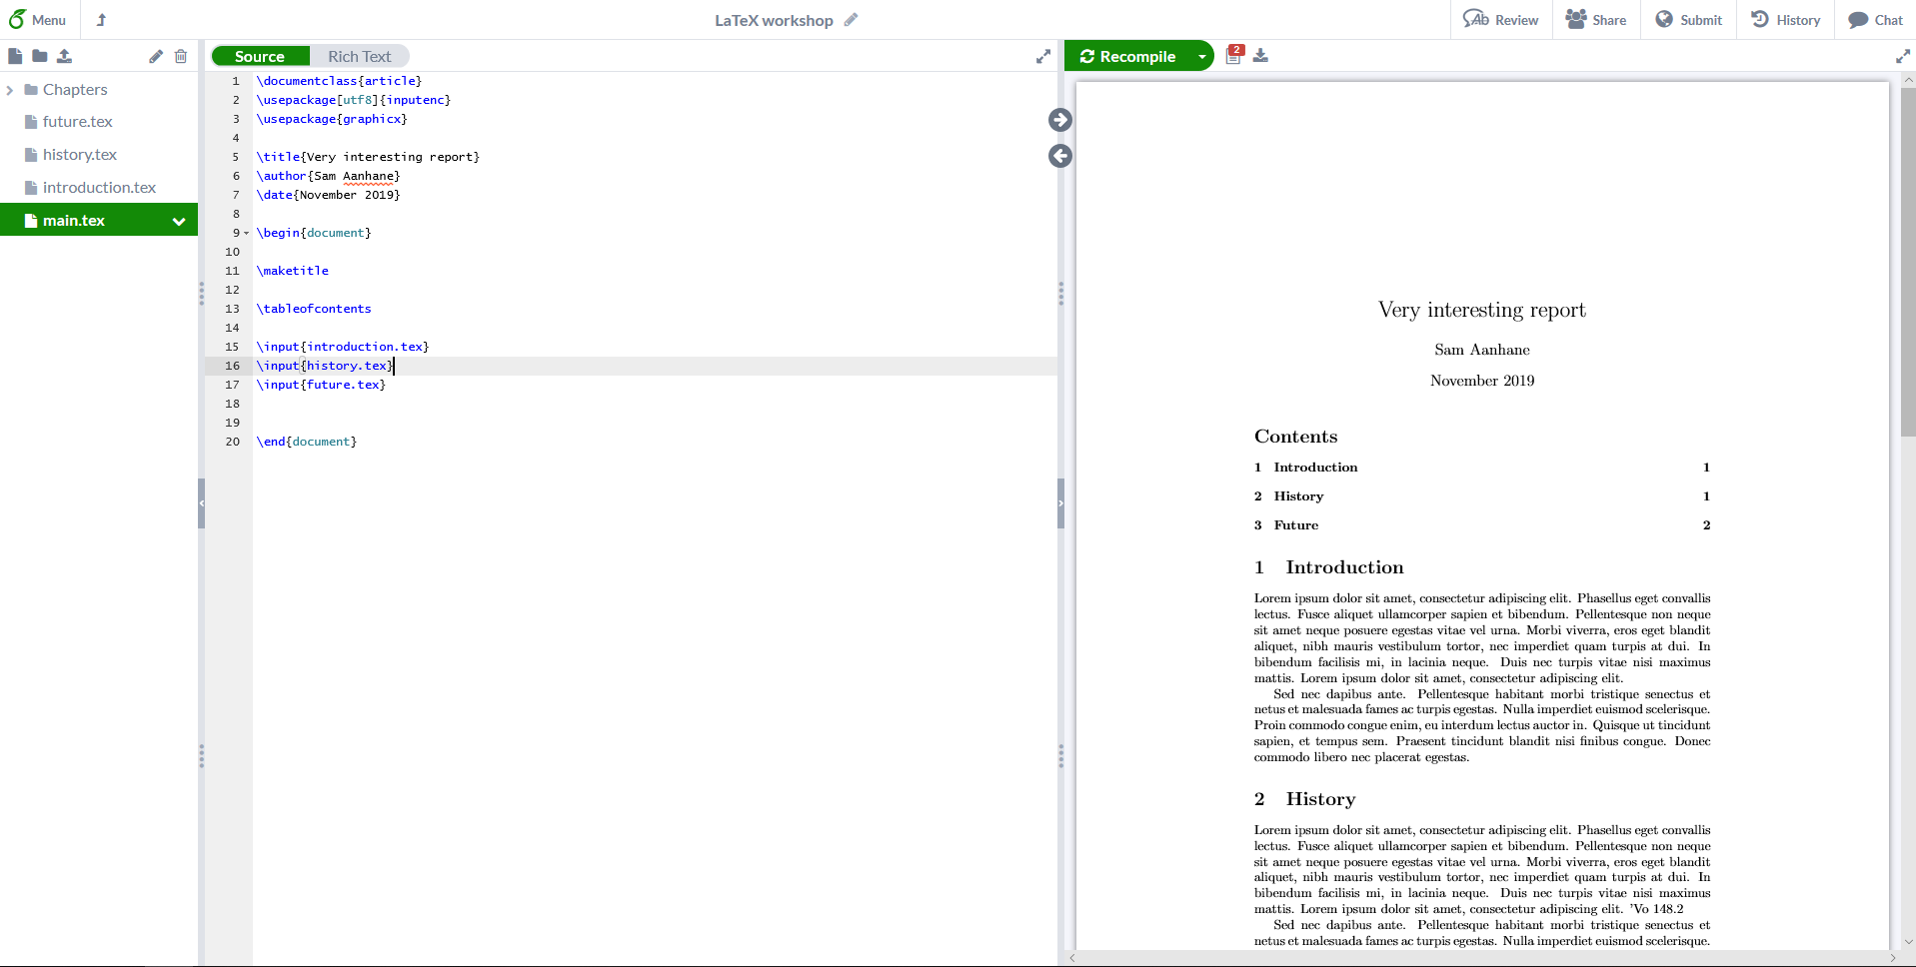
How do you use it?
Overleaf

Slide 12
How do you use it?
Files: separate chapters, images etc.

Slide 13
How do you use it?
Syntax: the actual LaTeX code

Slide 14
How do you use it?
Output: your PDF file

Slide 15
Do it yourself!
Register on Overleaf
Make a new project
Compile the standard file
A template file can be found on: etv.tudelft.nl/latex
A cheat sheet can be found on: etv.tudelft.nl/cheat

Slide 16
Structure and Content!

Slide 17
Structure
Preamble
  Document class
  Packages
Content
  Chapters and paragraphs
Optional: Bibliography
Notes:
*Bibliography only appears when used as cititations

Slide 18
Preamble
Document class: article, report, book, slides, letter, etc.
Packages: listings, babel, hyperref, graphicx, etc.
Title, author, date

Slide 19
Preamble
\documentclass[a4paper]{article}
\usepackage{graphicx}
\usepackage[english]{babel}
\title{Document title}
\author{the author}
\date{\today}
\begin{document}
% The document starts here

Slide 20
Content
Chapter format
Text
Images
Tables
Equations
Lists
Graphs
Etc…

Slide 21
Content
\section{Introduction}
\label{sec:introduction}
This is the introduction
\subsection{What is LaTeX?}
\label{sec:whatislatex}
This is a subsection of the introduction
\subsubsection{History}
\label{subsec:history}
Here is some information about the history

Slide 22
Excercise!
Make 3 chapters
Make 2 sections
Make 1 subsection
Make 3 paragraphs

Slide 23
Environments
Everything that is not text can be entered in the appropriate environment
Syntax: \begin{environment name}
  \begin{figure}
  \begin{table}
  \begin{equation}
Don’t forget the \end{environment name}!

Slide 24
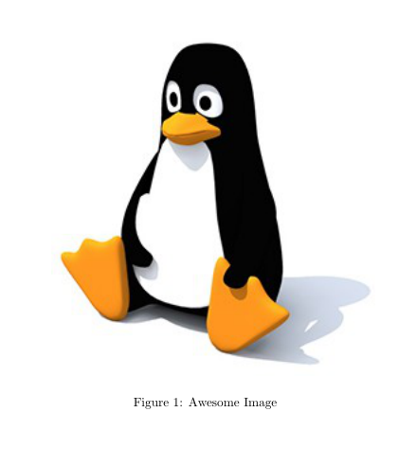
Figures
The package graphic is necessary
Example:
\begin{figure}[“specifier”]
\centering
\includegraphics[width=0.8\textwidth]{“directory”}
\caption{Awesome Image}
\label{fig:awesome_image}
\end{figure}
Specifiers: h, t, b, p, !, H
Notes:
h Place the float here, i.e., approximately at the same point it occurs in the source text (however, not exactly at the spot)
t Position at the top of the page.
b Position at the bottom of the page.
p Put on a special page for floats only.
! Override internal parameters LaTeX uses for determining "good" float positions.
H Places the float at precisely the location in the LATEX code. Requires the float package, though may cause problems occasionally. This is somewhat equivalent to h!.

Slide 25
Exercise!
Add an image somewhere
  Make sure you upload the image to Overleaf first!
Add a caption to the image

Slide 26
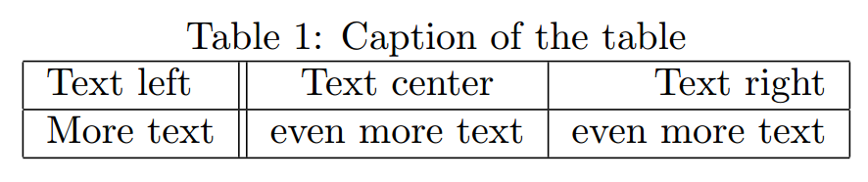
Tables
\begin{table}
\centering
  \label{tab:je_tabel}
  \caption{Caption of the table}
  \begin{tabular}{| l || c | r |}
    \hline
    Text left & Text center & Text right \\
    \hline
    More text & even more text & even more text \\
    \hline
  \end{tabular}
\end{table}

Slide 27
Exercise!
Insert the table below somewhere in your document
  Subscript and Ω, see cheat sheet (BONUS)
V_{in} | V_{out} | R_{ref} | I
2V | 3.8V | 150Ω | 115mA
… | … | … | …

Slide 28

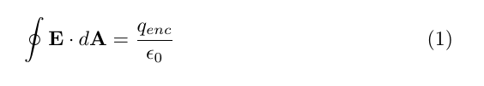
Equations
In-line equations
$f(x) = x^2 + 5 x + 3$
Freestanding equations
\begin{equation}
\label{eq:maxwell}
\oint \mathbf{E} \cdot d \mathbf{A} = \frac{q_{enc}}{\epsilon_0}
\end{equation}

Slide 29

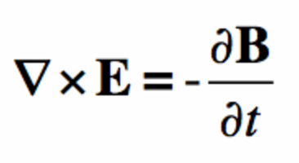
Exercise
Try to make the following in-line equation (cheatsheet + google)
Try to make the following freestanding equation (cheatsheet + Google, little more difficult!)

Slide 30
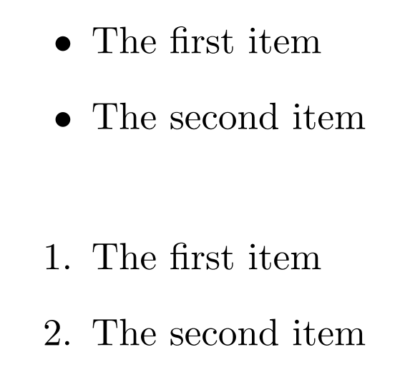
Lists
Lists can be made with itemize and enumerate
\begin{itemize}
\item The first item
\item The second item
\end{itemize}
\begin{enumerate}
\item The first item
\item The second item
\end{enumerate}

Slide 31
Some other features
Mark-ups
References
Bibliography/references
Inserting code
Include

Slide 32
Mark ups
Bold: \textbf{Text…}
{\bf Text…}
Italic: \textit{Text…}
{\it Text…}
Underline: \underline{Text…}
Super^{script}: \textsuperscript{Text…}
Sub_{script}: \textsubscript{Text…}

Slide 33
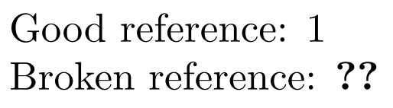
References
\label{your_label}
\ref{your_label} in the text
Useful name!
  fig:penguin
  eq:maxwell
  sec:introduction

Slide 34
Exercise!
Make, in a paragraph, a references to the image, the table and the equation you made earlier

Slide 35
Bibliography
In a .bib file
@book{epobook,
Author = "J. Hoekstra and X. van Rijnsoever",
Publisher = {TU Delft},
Title = {Lab Courses EE Semester 1 – Student Manual},
Year = {2015-2016}
}

Slide 36
Bibliography
This is what you put in the text:
A reference: \cite{epobook}
Another one: \cite[p.150]{epobook}
Output:
A reference: [1]
Another one: [1,p1.150]

Slide 37
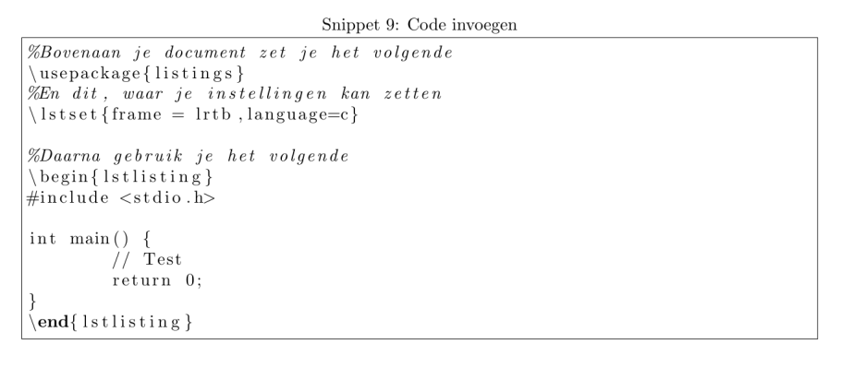
Inserting code
Listings, use package
  \usepackage{listings}
Settings (below the packages)
  \lstset{frame = lrtb,language=c}
  Documentation
And then:
\begin{lstlisting}[caption=caption, label={lst:cprog}]
// C code here
\end{lstlisting}

Slide 38
Miscellaneous
Inputting LaTeX file: \input{losse_file.tex}
Table of contents: \tableofcontents
Line break: \\
New page: \clearpage of \newpage
Prevent the line to indent: \noindent
Add a white space \newline
Accentuated characters:
  ë \”e
  é \’e
  è \`e
  ê \^e

Slide 39
Do it yourself!
Try to add a piece of code
Try to make a table of contents

Slide 40



Do you need any help?
Google is your friend!
LaTex documentation: en.wikibooks.org/wiki/LaTeX/
Overleaf
Experienced users

Slide 41
Templates
TUDelft report templates:
  Google: “TUDelft latex template”
  EPO templates: received from coordinators or Brightspace
ETV templates
  In the “Shared” folder

Slide 42
Other uses
Presentations
Labelprinting
Envelope printing
Batch generation of documents

Slide 43

That’s it!
etv.tudelft.nl/workshop

